Slide 1
Debugging in VS Code
Code Minions - Lunch & Learn
Terrence Mahnken – Application Engineer II

Slide 2
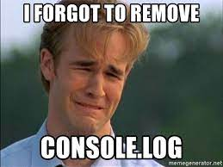
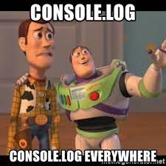
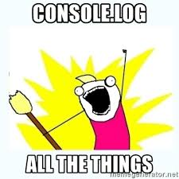
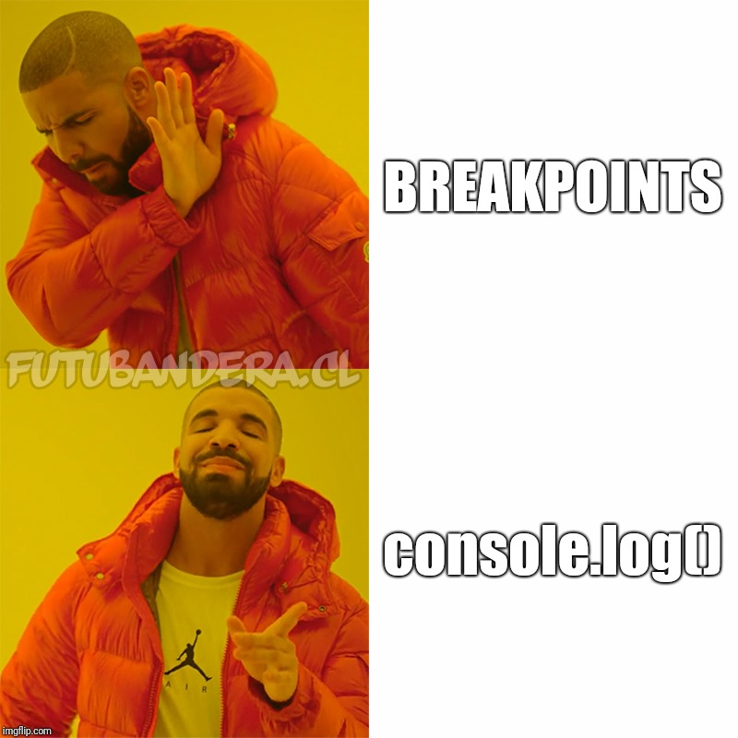
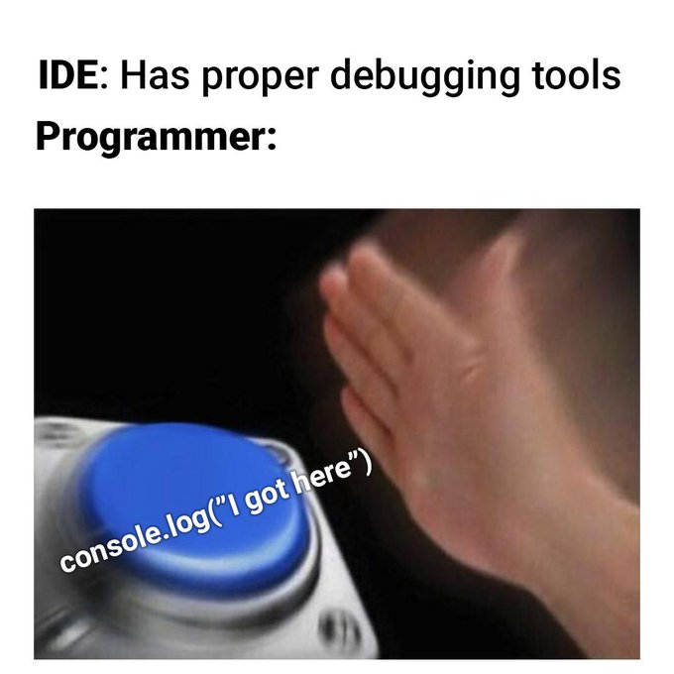
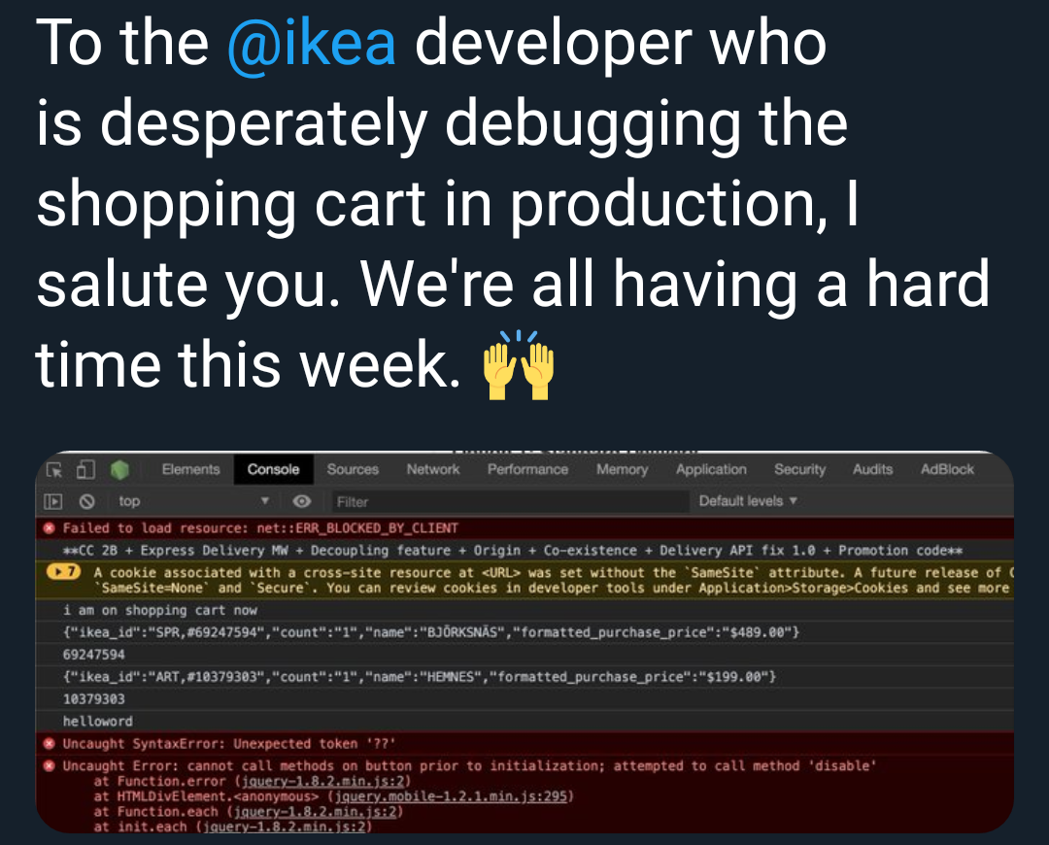
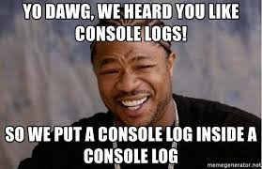

Slide 3
Agenda
VS Code Views
launch.json
Exercises

Slide 4
VS Code Views
Debugging in VS Code

Slide 5
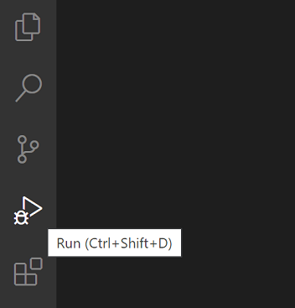
Activity Bar

Slide 6
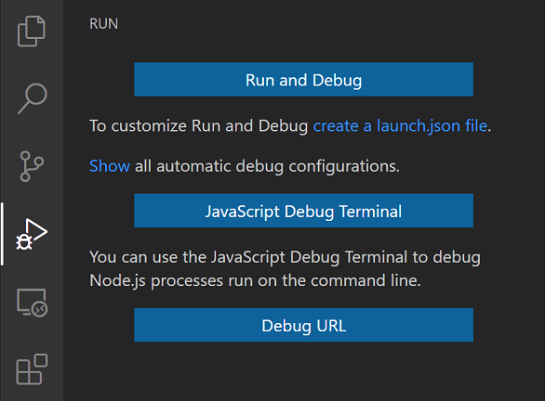
Run View
Default (no launch.json file)

Slide 7
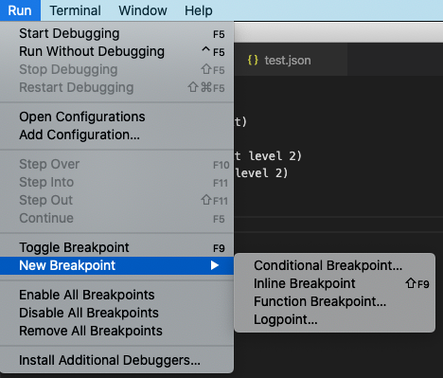
Run Menu

Slide 8
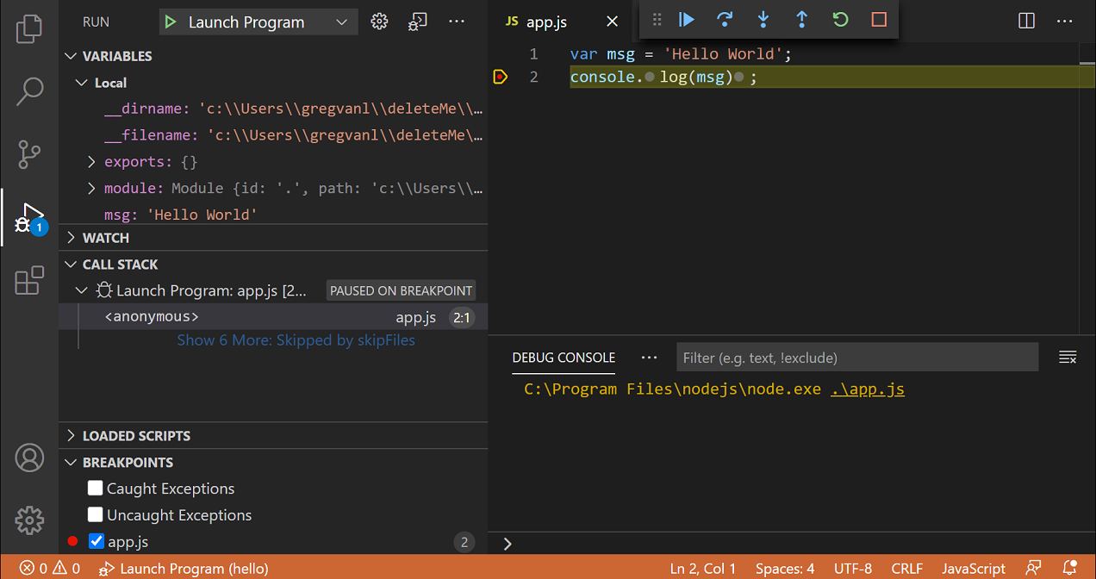
Running Debugging

Slide 9
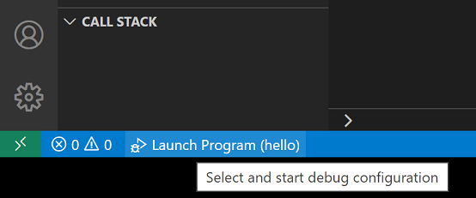
Debug Status Bar

Slide 10

Debug Toolbar
Left-to-Right
Continue/Pause
Step Over
Step Into
Step Out
Restart
Stop

Slide 11
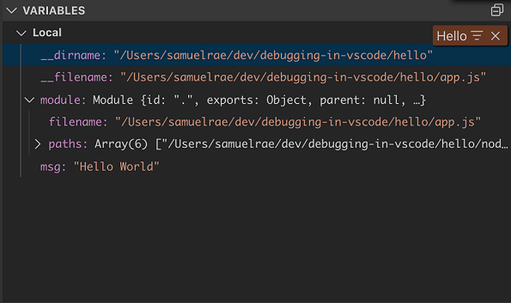
Variables Panel

Slide 12
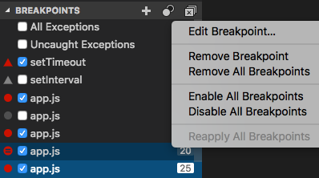
Breakpoints Panel

Slide 13
launch.json
Debugging in VS Code

Slide 14
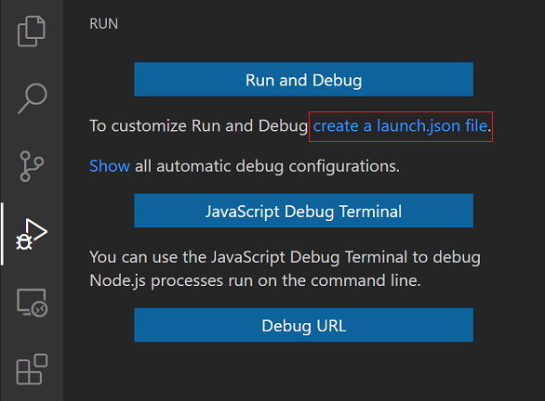
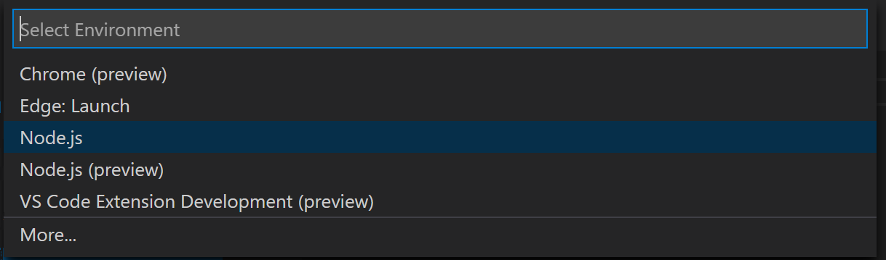
Overview
Configure and save debugging setup details
Saved as launch.json in .vscode directory
IntelliSense suggestions available for specific debugger

Slide 15
Required Attributes
type – type of debugger
request – launch or attach
name – reader-friendly name

Slide 16
Debugging Recipes
Node
React
Vue

Slide 17
Exercises
Debugging in VS Code

Slide 18
Thanks!
Terrence Mahnken
CDI Application Engineer II
Debugging in VS Code

